Slide 1
Software Evolution and Maintenance
A Practitioner’s Approach
Chapter 5
Legacy Information Systems
Notes:
Handouts
------------------------------------------------------------------
------------------------------------------------------------------
-------------------------------------------------------------------
--------------------------------------------------------------------

Slide 2
Outline of the Chapter
5.1 General Idea
5.2 Wrapping
5.2.1 Types of Wrapping
5.2.2 Levels of Encapsulation
5.2.3 Constructing a Wrapper
5.2.4 Adapting a Program for Wrapper
5.3 Migration
5.4 Migration Planning
5.5 Migration Methods
5.5.1 Cold Turkey
5.5.2 Database First
5.5.3 Database Last
5.5.4 Composite Database
5.5.5 Chicken Little
5.5.6 Butterfly
5.5.7 Iterative
Notes:
Handouts

Slide 3
5.1 General Idea
In Oxford English Dictionary (OED) the word “legacy” is defined as
  A sum of money, or a specified article, given to another by will; anything handed down by an ancestor or predecessor.
Brodie and Stonebraker used the following definition to define legacy systems:
  any information system that significantly resists modification and evolution to meet new and constantly changing business requirements.
Bennett used the following definition to define legacy systems:
  Legacy software systems are large software systems that we don’t know how to cope with but that are vital to our organization.
Supporting the definitions are a set of acceptable features of a legacy system:
  • large with millions of lines of code.
  • geriatric, often more than 10 years old.
  • written in obsolete programming languages.
  • lack of consistent documentation.
  • poor management of data, often based on flat-file structures.
  • degraded structure following years of modifications.
  • very difficult, if not impossible, to expand.
  • runs on old processor.
Notes:
Handouts

Slide 4
5. 1General Idea
There are several categories of solutions for legacy information system (LIS).
These solutions generally fall into six categories as follows:
  • Freeze.
  • Outsource.
  • Carry on maintenance.
  • Discard and redevelop.
  • Wrap.
  • Migrate.
Notes:
Handouts

Slide 5
5.2 Wrapping
In 1988, Dietrich et al. first introduced the concept of a “wrapper” at IBM.
Wrapping means encapsulating the legacy component with a new software layer that provides a new interface and hides the complexity of the old component.
The encapsulation layer can communicate with the legacy component through sockets, remote procedure calls (RPCs), or predefined application program interfaces (API).
The wrapped component is viewed similar to a remote server; it provides some service required by a client that does not know the implementation details of the server.
Notes:
Handouts

Slide 6
5.2 Wrapping
By means of a message passing mechanism, a wrapper connects to the clients.
On the input front, the wrapper accepts requests, restructures them, and invokes the target object with the restructured arguments.
On the output front, the wrapper captures outputs from the wrapped entity, restructures the outputs, and pushes them to the requesting entity.
However, this technique does not solve the problems with legacy systems.
Notes:
Handouts

Slide 7
5.2.1 Types of Wrapping
Orfali et al. classified wrappers into four categories:
  Database wrappers.
  System service wrappers.
  Application wrappers.
  Function wrappers.
Database wrappers:
Database wrappers can be further classified into forward wrappers (f-wrappers) and backward wrappers (b-wrappers)
The forward wrappers-approach, depicted in Figure 5.1, shows the process of adding a new component to a legacy system.
Therefore, by means of translation service involving both legacy data and queries, the wrapper integrates the new component with the legacy system.
The backward wrappers-approach has been depicted in Figure 5.2
In this approach, data are migrated first then new components are developed that use the new database; the legacy components access the new data via wrappers.
Notes:
Handouts

Slide 8
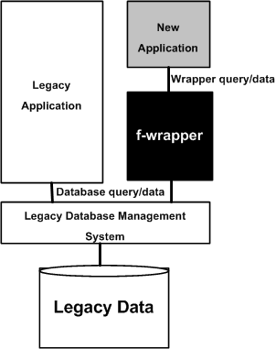
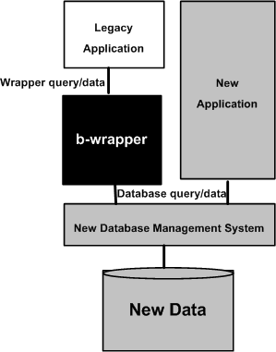
5.2.1 Types of Wrapping
Figure 5.1Forward wrapper © ACM, 2006
Figure 5.2 Backward wrapper © ACM, 2006
Notes:
Handouts

Slide 9
5.2.1 Types of Wrapping
System service wrappers:
This kind of wrappers support customized access to commonly used system services, namely, routing, sorting, and printing.
A client program may access those services without knowing their interfaces.
Application wrappers:
This kind of wrappers encapsulate online transactions or batch processes.
These wrappers enable new clients to include legacy components as objects and invoke those objects to produce reports or update files.
Function wrappers:
This kind of wrappers provide an interface to call functions in a wrapped entity.
In this mechanism, only certain parts of a program – and not the full program – are invoked from the client applications.
Therefore, limited access is provided by function wrappers.
Notes:
Handouts

Slide 10
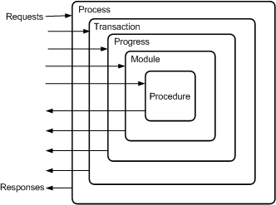
5.2.2 Levels of Encapsulation
Sneed classified five levels of granularity: procedures are at the lowest level and processes are at the highest level.
Figure 5.3 Levels of encapsulation ©IEEE, 1996
Notes:
Handouts

Slide 11
5.2.2 Levels of Encapsulation
Process level:
A job is started on the server which accepts input data, accesses databases, and produces output data.
The input data and output data are contained in files.
The input files are created by the client program and are transferred to the server by the wrapper by means of a standard file transfer utility.
Upon the completion of the job, the wrapper takes over the output files to be forwarded to the client.
Notes:
Handouts

Slide 12
5.2.2 Levels of Encapsulation
Transaction level:
On the server, a virtual terminal is created that sends the terminal input map and receives the terminal output map.
The wrapper is a program which simulates the user terminal.
This type transaction level wrapping has become simple because modern transaction processors:
  (i) take care of host-to-client communication.
  (ii) perform restart and recovery task, exception handling, rollback, and commit.
Notes:
Handouts

Slide 13
5.2.2 Levels of Encapsulation
Program level:
Via APIs, batch programs are called in a wrapper.
The wrapper substitutes program inputs with data inputs coming in from the client application.
In addition, outputs from the wrapped program are captured, reformatted, and sent to the client.
Notes:
Handouts

Slide 14
5.2.2 Levels of Encapsulation
Module level:
Legacy modules are executed using their standard interfaces.
A significant deviation from the usual calls is that parameters are passed by value – and not by references.
Therefore, first, the wrapper buffers the received values in its own address space.
Next, the buffered values are passed on to the invoked module.
Finally, the output values received from the invoked module are passed on to the client.
Notes:
Handouts

Slide 15
5.2.2 Levels of Encapsulation
Procedure level:
A procedure internal to the system is invoked as if the procedure was compiled separately.
As a result, this special treatment of an internal procedure requires:
  (i) constructing a parameter interface; and
  (ii) if needed, initializing global variables before calling the procedure.
Notes:
Handouts

Slide 16
5.2.3 Constructing a Wrapper
A legacy system is wrapped in three steps as follows:
  A wrapper is constructed.
  The target program is adapted.
  The interactions between the target program and the wrapper are verified.
A wrapper, is a program which receives input messages from the client program, transforms the inputs into an internal representation, and invokes the target system with the newly formatted messages.
The wrapper intercepts the outputs produced by the target system, transforms them into a format understood by the client, and transfers them to the client.
Notes:
Handouts

Slide 17
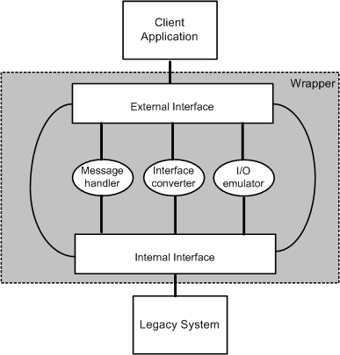
5.2.3 Constructing a Wrapper
Conceptually, a wrapper comprises two interfaces and three event driven modules as shown in Figure 5.4.
The two interfaces are an internal interface and an external interface, and the three modules are message handler, interface converter, and I/O-emulator.
Figure 5.4 Modules of a wrapping framework
Notes:
Handouts

Slide 18
5.2.3 Constructing a Wrapper
External interface:
The interface of the wrapper that is accessed by the clients is called the external interface.
The wrapper and its client generally communicate by passing messages.
Messages normally comprise a header and a body.
The header of a message contains control information:
  (i) identity of the sender.
  (ii) a time stamp.
  (iii) the transaction code.
  (iv) target program type.
  (v) the identity of the transaction, program, procedure, or module to be invoked.
The message body contains the input arguments. Similarly, the message body contains the output values in an output message.
The values contained in a message are normally ASCII strings separated by a delimiter, say, a back slash ( “\” ).
Notes:
Handouts

Slide 19
5.2.3 Constructing a Wrapper
Internal interface:
A wrapper’s internal interface is the interface visible to the server.
The internal interface is dependent upon the language and type of the wrapped entity.
For example, if the wrapped entity is a job, the internal interface of the wrapper is a job control procedure, and the job control procedure is interpreted to execute the job.
On the other hand, if the encapsulated entity is a program, procedure, transaction, or a module, the internal interface is alist of parameters in the language of the encapsulated software.
Therefore, the internal interface is extracted from the source code of the encapsulated software.
The parameters of the internal interface are specified in terms of the target language, thereby necessitating a translation from the input ASCII strings to the target types.
Notes:
Handouts

Slide 20
5.2.3 Constructing a Wrapper
Message handler:
The message handler buffers input and output messages, because requests from the client may occasionally arrive at a faster rate than they can be consumed.
Similarly, outputs from the wrapped program may be produced at a faster rate than they can be sent to the client.
Interface converter:
This entity converts the internal interface into the external interface and vice-versa.
I/O-emulator:
I/O-emulator intercepts the inputs to and outputs from the wrapped entity.
Upon intercepting an input, the emulator fills the input buffer with the values of the parameters of the internal interface.
On the other hand, when it intercepts an output value, the emulator copies the contents of the output buffer into the parameter space of the external interface.
Notes:
Handouts

Slide 21
5.2.4 Adapting a Program for Wrapper
A wrapped program is modified to some extent, and it is expected that the modified programs continue to operate in the normal mode.
Programs are adapted with tools, rather than manually.
Sneed recommended four types of tools:
  Transaction wrapper.
  Program wrapper.
  Module wrapper.
  Procedure wrapper.
Notes:
Handouts

Slide 22
5.2.5 Screen Scraping
Screen scraping is a common form of wrapping in which modern, say, graphical, interfaces replace text-based interfaces.
The new interface can be a GUI (graphical user interface) or even a web-based HTML (hypertext markup language) client.
Tools, such as Verastream from Attachmate, automatically generate the new screens.
Screen scraping simply provides a straightforward way to continue to use a legacy system via a graphical user interface.
Screen scraping is a short term solution to a larger problem.
Many serious issues are not addressed by simply mounting a GUI on a legacy system. For example, screen scraping:
  (i) does not evolve to support new functions.
  (ii) incurs high maintenance cost.
  (iii) ignores the problem of overloading.
  Overloading is simply defined as the ability of one function to perform different tasks.
Notes:
Handouts

Slide 23
5.3 Migration
Migration of LIS is the best alternative, when wrapping is unsuitable and redevelopment is not acceptable due to substantial risk.
However, it is a very complex process typically lasting five to ten years.
It offers better system understanding, easier maintenance, reduced cost, and more flexibility to meet future business requirements.
Migration involves changes, often including restructuring the system, enhancing the functionality, or modifying the attributes.
It retains the basic functionality of the existing system.
We will discuss general guidelines for migrating a legacy system to a new target system.
A brief overview of the migration steps is explained next.
Notes:
Handouts

Slide 24
5.3 Migration
LIS migration involves creation of a modern database from the legacy database and adaptation of the application program components accordingly.
A database has two main components: schema of the database and data stored in the database.
Therefore, in general, migration comprises three main steps:
    (i) conversion of the existing schema to a target schema;
    (ii) conversion of data; and
    (iii) conversion of program.
Schema conversion:
Schema conversion means translating the legacy database schema into an equivalent database structure expressed in the new technology.
The transformation of source schema to a target schema is made up of two processes.
The first one is called DBRE and it aims to recover the conceptual schema that express the semantics of the source data structure, which is discussed in Section 4.8.
Notes:
Handouts

Slide 25
5.3 Migration
The second process is straightforward and it derives the target physical schema from this conceptual schema:
  (i) an equivalent logical schema is obtained from the conceptual schema by means of transformations; and
  (ii) a physical schema is obtained from the logical schema by means of transformations.
Data Conversion:
Data conversion means movement of the data instances from the legacy database to the target database.
Data conversion requires three steps: extract, transform, and load (ETL).
First, extract data from the legacy store. Second, transform the extracted data so that their structures match the format.
In addition, perform data cleaning (a.k.a. scrubbing or cleansing) to fix or discard data that do not fit the target database.
Finally, load the transformed data in the target database.
Notes:
Handouts

Slide 26
5.3 Migration
Program Conversion:
In the context of LIS migration, program conversion means modifying a program to access the migrated database instead of the legacy data.
The conversion process leaves the functionalities of the program unchanged.
Program conversion depends upon the rules that are used in transforming the legacy schema into the target schema.
Testing and Functionality:
It is important to ensure that the outputs of the target system are consistent with those of the LIS.
Therefore, new functionality is not to be introduced into the target system in a migration project.
If both the LIS and the target system have the same functionality, it is easier to verify their outputs for compliance.
However, to justify the project expense and the risk, in practice, migration projects often add new functionalities.
Notes:
Handouts

Slide 27
5.3 Migration
Cut over or Roll over:
The event of cutting over to the new system from the old one is required to cause minimal disruption to the business process.
There are three kinds of transition strategies.
Cut-and-Run: The simplest transition strategy is to switch off the legacy system and turn on the new system.
Phased Interoperability: To reduce risks, cut over is gradually performed in incremental steps.
Parallel Operation: The target system and the LIS operate at the same time. Once the new system is considered to be reliable, the LIS is taken off service.
Notes:
Handouts

Slide 28
5.4 Migration Planning
The activity of planning for migration comprises thirteen steps:
Step 1: Perform portfolio analysis.
Step 2: Identify the stakeholders.
Step 3: Understand the requirements.
Step 4: Create a business case.
Step 5: Make a go or no-go decision.
Step 6: Understand the LIS.
Step 7: Understand the target technology.
Step 8: Evaluate the available technologies.
Step 9: Define the target architecture.
Step 10: Define a strategy.
Step 11: Reconcile the strategy with the needs of the stakeholder.
Step 12: Determine the resources required.
Step 13: Evaluate the feasibility of the strategy.
Notes:
Handouts

Slide 29
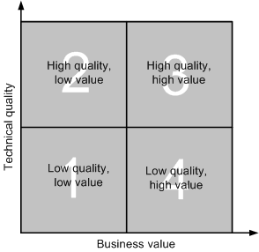
5.4 Migration Planning
Step 1: Perform portfolio analysis.
Portfolio analysis establishes measures of technical quality and business value for a set of software systems.
It is represented on a chi-square chart as shown in Figure 5.5.
Quadrant 1: A system with low technical quality and low business value is a prime candidate for substitution with a commercial product, if one is available. These systems might be in use in the non-core sector of the organization.
Quadrant 2: A system with high technical quality but low business value need not be replaced, migrated, or restructured.
Quadrant 3: A system with high technical quality and high business value should be actively evolved.
Quadrant 4: A system with low technical quality but high business value is a good candidate for redevelopment or migration to a new system.
Figure 5.5 Portfolio analysis chi-square chart
Notes:
Handouts

Slide 30
5.4 Migration Planning
Step 2: Identify the stakeholders.
Stakeholders are the people or organizations that influence a system’s behavior, or those who are impacted by the system.
Stakeholders typically include architects, developers, maintainers, managers, customers, and end users.
The stakeholders ultimately judge the outcome and impact of the migration project.
Each of the stakeholders bring their own perspectives to the table.
Therefore, it is necessary to obtain their agreement and support.
Notes:
Handouts

Slide 31
5.4 Migration Planning
Step 3: Understand the requirements.
Requirements are a description of the needs and desires of stakeholders that a system is expected to implement:
There are two challenges in defining requirements.
  First, ensure that the right requirements are captured.
  Second, express the requirements in such a way that the stakeholders can easily review and confirm their correctness.
Therefore, it is essential to have an unambiguous representation of the requirements and have it made available in a centralized database so that all the stakeholders can review and validate the requirements.
Requirements can come from:
  Legacy Information System
  Business Process Reengineering
  Stakeholders
Notes:
Handouts

Slide 32
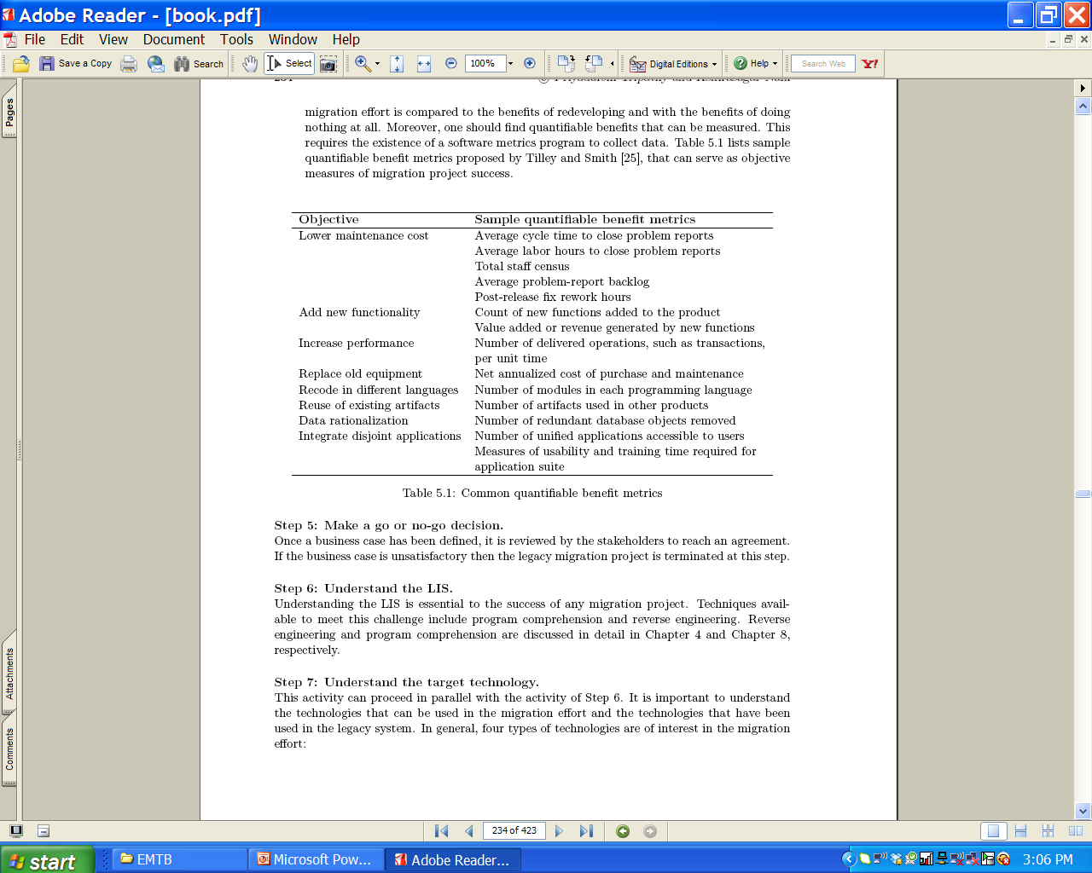
5.4 Migration Planning
Step 4: Create a business case.
Based on a business case, executive management can decide whether or not the migration project will increase quality, reduce maintenance costs, and be financially viable.
In general, a good business case provides the following information about the migration project:
  Problem statement; Solution; Risks; and Benefits.
Notes:
Handouts

Slide 33
5.4 Migration Planning
Step 5: Make a go or no-go decision.
Once a business case has been defined, it is reviewed by the stakeholders to reach an agreement.
If the business case is unsatisfactory then the legacy migration project is terminated at this step.
Step 6: Understand the LIS.
Understanding the LIS is essential to the success of any migration project.
Techniques available to meet this challenge include program comprehension and reverse engineering.
Notes:
Handouts

Slide 34
5.4 Migration Planning
Step 7: Understand the target technology.
This activity can proceed in parallel with the activity of Step 6.
It is important to understand the technologies that can be used in the migration effort and the technologies that have been used in the legacy system.
In general, four types of technologies are of interest in the migration effort:
  1. Languages and DBMS available, including COBOL, Java, eXtensible Markup Language (XML), and modern DBMS.
  2. Distributed transaction models, including distributed communication and transaction technologies such as remote procedure calls (RPC) or message queues.
  3. Middleware technologies and standards that may be used to develop an information system, including message-oriented middleware (MOM), XML Messaging, Java 2 Enterprise Edition (J2EE), and Enterprise JavaBeans (EJB).
  4. Tools that are available to assist in migration of the LIS to the new information system.
Notes:
Handouts

Slide 35
5.4 Migration Planning
Step 8: Evaluate the available technologies.
One must compare and contrast all the available technologies to evaluate their capabilities.
If the capabilities overlap, then we must appraise these technologies to understand the quality of service they will provide in the migration process.
To formulate the eventual architecture and design of the system, those evaluations are performed.
Step 9: Define the target architecture.
The target architecture is the desired architecture of the new system.
It models the stakeholders’ vision of the new system.
This usually requires descriptions using different views with different levels of granularity.
The target architecture is likely to evolve during the migration process.
Therefore, the target architecture is continually reevaluated and updated during the migration process.
Notes:
Handouts

Slide 36
5.4 Migration Planning
Step 10: Define a strategy.
A strategy defines the overall process of transforming the LIS to the new system.
This includes migration methodology, that is schema conversion, data conversion, and program conversion, testing, and cut over.
For a mission-critical legacy system, deploying the new system all at once is a risky procedure, therefore a legacy system is evolved incrementally to the new system.
During the migration effort, many things can change: user requirements may change, additional knowledge about the system may be acquired, and the technology may change.
Those changes must be accommodated by the migration effort.
While accommodating those changes, a migration strategy need to minimize risk, minimize development and deployment costs, support an aggressive but reliable schedule, and meet system quality expectations.
Notes:
Handouts

Slide 37
5.4 Migration Planning
Step 11: Reconcile the strategy with the needs of the stakeholder.
A consensus needs to be developed among stakeholders before implementing the migration plan.
The migration strategy developed in the previous step must be reconciled with stakeholder needs.
Therefore, this step includes briefing the stakeholders about the approach, reviewing the target architecture, and the strategy.
The entire group evaluates the strategy and provides input for the final consensus profile.
Step 12: Determine the resources required.
We estimate the resource need including cost of implementing the project.
One can use the widely used cost estimation model called Constructive Cost Model II (COCOMO II).
COCOMO II addresses nonsequential process models, reengineering work, and reuse-driven approach.
The COCOMO II model provides estimates of effort, schedule by phases, and staffing by phases and activities.
Notes:
Handouts

Slide 38
5.4 Migration Planning
Step 13: Evaluate the feasibility of the strategy.
After executing the first 12 steps, the management should have an understanding of the system under migration, the available technology options, a target architecture, migration strategy, cost of migration, and a schedule to effect migration.
Based on available information, management determines whether or not the migration strategy is feasible.
If the strategy is found to be viable, the migration plan is finalized.
On the other hand, if it is unacceptable, a detailed report is produced.
Based on the reasons stated in the report, one may revise the migration strategy until:
  (i) a feasible approach can be identified, or
  (ii) the migration strategy is determined to be infeasible and the project is terminated.
Notes:
Handouts

Slide 39
5.5 Migration Methods
No single approach can be applied to all kinds of legacy systems, because they vary in their scale, complexity, and risks of failure while migrating.
The seven approaches are as follows:
  Cold turkey
  Database first
  Database last
  Composite database
  Chicken little
  Butterfly
  Iterative
Notes:
Handouts

Slide 40
5.5.1 Cold Turkey
The Cold turkey strategy is also referred to as the Big Bang approach.
It involves redesigning and recoding the LIS from the very beginning using a new execution platform, modern software architecture, and new tools and databases.
For this approach to be adopted, one must guarantee that the renovated system will include many new features in addition to the functionality provided by the original legacy system.
The risk of failure is increased due to the complexity of migration.
This approach can be adopted, if a legacy system has stable, well-defined functionality and is small in size.
Notes:
Handouts

Slide 41
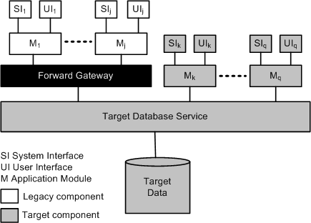
5.5.2 Database First
The Database first approach is also known as forward migration method.
This method first migrates the database, including the data, to a modern DBMS, and then gradually migrates the legacy application programs and interfaces.
The LIS simultaneously operates with the new system via a forward gateway, while interfaces and legacy applications are being reengineered.
Implemented as a software module, a gateway mediates among operational software components.
This enables the LIS applications to access the database on the target side as shown in Figure 5.6.
The forward gateway translates legacy application calls to target calls.
Similarly, outputs of the reengineered database are translated for use by the legacy system.
Figure 5.6 Database first approach ©IEEE, 1999
Notes:
Handouts

Slide 42
5.5.2 Database First
A key benefit of the database-first approach is that upon the completion of migration of the legacy data, one can start receiving productivity benefits by accessing the data.
The legacy system can operate concurrently with those applications and interfaces that have been migrated to the new system.
This approach has three major drawbacks.
  First, the approach is only applicable to a completely decomposable legacy system, where a clean interface to the legacy database exists.
  Second, the new database structure must be defined before migration can begin.
  Third, it is difficult to construct the forward gateway.
An information system is said to be fully decomposable if the user and system interfaces, applications, and databases are considered to be distinct components connected by clearly defined interfaces.
In a semidecomposable information system, only the user and the system interfaces are separate components; the database service and applications are inseparable.
A nondecomposable information system is one where no functional components can be separated
Notes:
Handouts

Slide 43
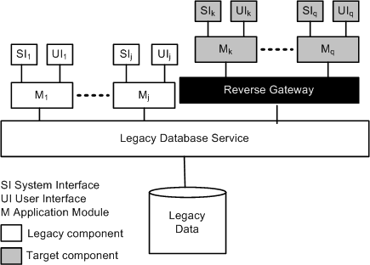
5.5.3 Database Last
It is suitable only for a fully decomposable LIS.
In this approach, legacy applications are incrementally migrated to the target platform, but the legacy database stays on the original platform.
Migration of the database is done last.
Similar to the database-first approach, interoperability of both, the information systems is supported by means of a gateway.
Target applications access the LIS database via a reverse gateway.
As illustrated in Figure, the reverse gateway translates calls
from the new applications and redirects them to the legacy database.
Figure 5.7 Database last approach ©IEEE, 1999
Notes:
Handouts

Slide 44
5.5.3 Database Last
There are two main issues with the Database last approach:
  First, mapping from the schema of the target database to the legacy database can be slow, thereby impacting new applications.
  Second, several useful features of relational databases, namely, triggers, integrity, and constraints may not be exploited by the new applications, because those features might not be present in the legacy database.
Notes:
Handouts

Slide 45
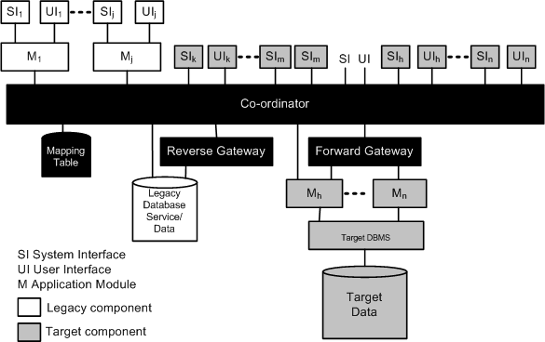
5.5.4 Composite Database
The Composite database approach is applicable to fully decomposable, semidecomposable, and non-decomposable legacy information systems.
In the composite database approach, the target information system is run in parallel with the legacy system during the migration process.
In the beginning, the target system is a small one, but it grows in size as migration continues.
While migration is continuing, as shown in Figure 5.8, the two systems form a composite information system, employing a
combination of forward and reverse gateways.
Figure 5.8 Composite database approach ©IEEE, 1999
Notes:
Handouts

Slide 46
5.5.4 Composite Database
Upon completion of the migration process, all the functionality of the old system are performed by the new system.
In this approach, data may be duplicated across both the databases: legacy and target.
A transaction co-coordinator is employed to maintain data integrity.
The co-coordinator intercepts update requests from both target and legacy applications, and processes the requests to determine whether or not the requests refer to data replicated in both the databases.
If replicated data are referred to, the update is propagated to both the databases using a two-phase commit protocol.
As done in the Database-first and Database-last approaches, the composite database approach does not require a one-shot large migration of legacy data.
Notes:
Handouts

Slide 47
5.5.5 Chicken Little
The Chicken little strategy refines the composite database strategy, by proposing migration solutions for fully decomposable, semidecomposable, and nondecomposable legacy systems with different kinds of gateways.
The differences between those gateways are based upon:
  (i) the locations of the gateways in the system; and
  (ii) the degree of functionality of the gateways.
For a fully decomposed LIS, a database gateway is located between the database service and the application modules.
The said database gateway can be either a forward gateway or a reverse gateway.
Both the forward gateway and reverse gateway are also known as database gateways.
An application gateway is used for a semidecomposable LIS.
Notes:
Handouts

Slide 48
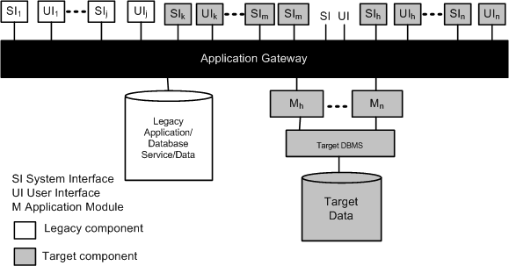
5.5.5 Chicken Little
The application gateway has been illustrated in Figure 5.9, and it is located between user and system interfaces and the legacy application.
It is called application gateway because it encapsulates from the applications down, from the perspective of interfaces.
Figure 5.9 Application gateway ©IEEE, 1999
Notes:
Handouts

Slide 49
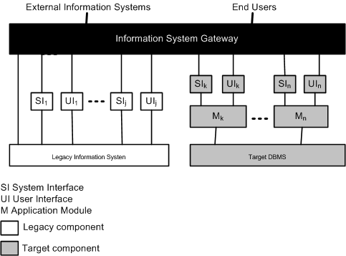
5.5.5 Chicken Little
For nondecomposable systems an information systems gateway is located between user and other information systems and LIS.
This gateway has been illustrated in the Figure 5.10.
The entire functionality of the legacy system is encapsulated in an information system gateway, whereas an application gateway encapsulates part of the legacy system, namely, only from application module down.
Figure 5.10 information system gateway ©IEEE, 1999
Notes:
Handouts

Slide 50
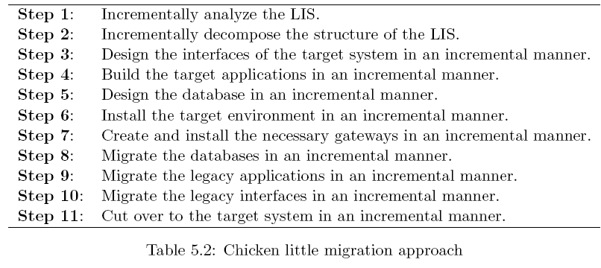
5.5.5 Chicken Little
The Chicken little methodology proposes an 11-step generic strategy, as listed on Table 5.2, for migration projects.
The flow of steps is for eachincrement to be migrated, so the entire flow is repeated for each increment.
In this methodology, using gateways, the legacy system and the target information system run concurrently during the entire process of migration.
In the Chicken little methodology, data is stored in both the migrating legacy system and the evolving target system.
Notes:
Handouts

Slide 51
5.5.6 Butterfly
The Butterfly methodology does not require simultaneous accesses of both the legacy database system and the target database system.
The target system is not operated in the production mode, at the time of reengineering the legacy system.
In other words, the old system being reengineered remains operational during the migration stage.
During the migration process, live data are not simultaneously stored in both the new system and the legacy system.
For data migration, the Butterfly methodology introduces the following concepts:
  Sample DataStore, Legacy SampleData, and Target SampleData;
  TempStore;
  Data-Access-Allocator;
  Data-Transformer;
  Termination-Condition and Threshold Value.
Notes:
Handouts

Slide 52
5.5.6 Butterfly
A representative subset of the legacy database is held in Legacy SampleData
The Target SampleData is derived from the Legacy SampleData.
Based on the data model of the target system, Sample DataStore stores the Target SampleData.
The Sample DataStore supports the initial development and testing of all components.
In order to migrate legacy data, the methodology uses a sequence of temporary datastores called TempStores (TS).
During the migration process, the TempStores hold the results of manipulations on the legacy data.
When migration of legacy data begins, the Data-Access-Allocator (DAA) directs those manipulations, and the results are stored/retrieved by the DAA in the most recent TempStore.
To migrate the legacy data and the TempStores data to the target system, the methodology uses a Data-Transformer called Chrysaliser.
Notes:
Handouts

Slide 53
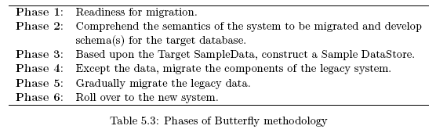
5.5.6 Butterfly
To determine whether or not the new system is ready to be used, the concepts of Termination-Condition and Threshold Value are introduced.
The Threshold Value is represented by a pre-determined value ε.
Basically, ε represents the acceptable quantity of data remaining in the current TS.
The condition size(TS) ≤ ε implies that the time required to migrate the data is negligibly small to shutdown the legacy system without inflicting much disturbance on the core business.
As shown in Table 5.3, migration of a legacy system is organized into six major steps, also called phases.
Notes:
Handouts

Slide 54
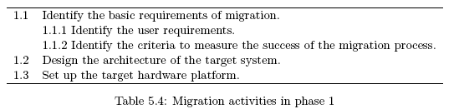
5.5.6 Butterfly
Phase 1: Readiness for migration
Considered to be important issues in the Butterfly methodology are user’s requirements and determination of the target system. Table 5.4 lists the main activities in the preparation phase.
Notes:
Handouts

Slide 55
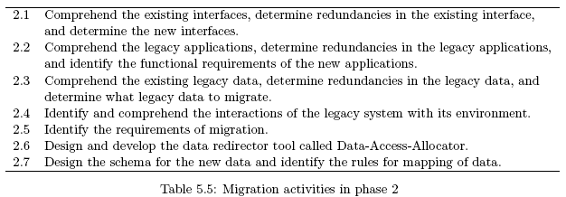
5.5.6 Butterfly
Phase 2: Comprehend the semantics of the system to be migrated and develop schema(s) for the target database
Table 5.5 shows the activities performed in this phase.
The migration requirements are finalized in activity 2.5.
However, not all requirements can be identified until the legacy system is fully understood.
In this phase, the Data-Access-Allocator (DAA) tool is developed to redirectall manipulations of legacy data and data stored in TempStores.
Notes:
Handouts

Slide 56

5.5.6 Butterfly
Phase 3: Based upon the Target SampleData, construct a Sample DataStore
The activities of Phase 3 are listed on Table 5.6.
Developing the Chrysaliser and determining the legacy SampleData are the main tasks in Phase 3.
The Chrysaliser derives the Sample DataStore from the SampleData, and the Sample DataStore is used to test and develop the target system.
Notes:
Handouts

Slide 57
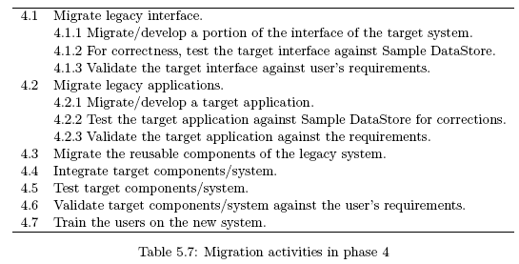
5.5.6 Butterfly
Phase 4: Except the data, migrate the components of the legacy system
The activities in Phase 4 are listed on Table 5.7.
In this phase, forward software engineering principles and methods are used in the migration process.
Constructed in Phase 2, the Sample DataStore is used in supporting the “design-develop-test” cycle for new target components.
The interactions among the target system’s components are verified in activity 4.4.
Notes:
Handouts

Slide 58
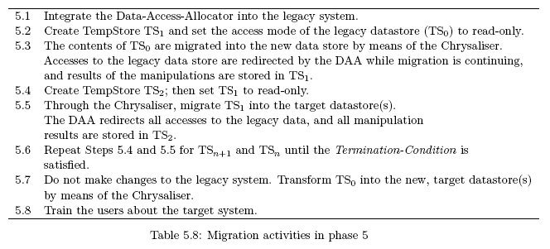
5.5.6 Butterfly
Phase 5: Gradually migrate the legacy data
Table 5.8 lists the activities of Phase 5.
Migration of legacy data is performed in Phase 5, and it is central to the Butterfly methodology. Legacy data are incrementally migrated by using TempStores, the Chrysaliser, and the Data-Access-Allocator (DAA).
Notes:
Handouts

Slide 59
5.5.6 Butterfly
Phase 5: Gradually migrate the legacy data (Cont’d…)
Once migration of legacy data is started, no changes are allowed to be performed on the legacy data store.
The Data-Access-Allocator (DAA) redirects manipulation operations of legacy data, and the results are saved in a series of TempStore(s) (TS).
When a legacy application needs to access data, the DAA correctly decides which source – the correct TempStore or the legacy data – to retrieve the data from.
By means of a Data-Transformer, called Chrysaliser, data are migrated to the new system from the legacy store and the series of TempStores.
A series of temporary stores (TS’s) are used by the Chrysaliser in the data migration process.
During the migration process in this methodology, the legacy system is not inaccessible for a significant amount of time.
Notes:
Handouts

Slide 60
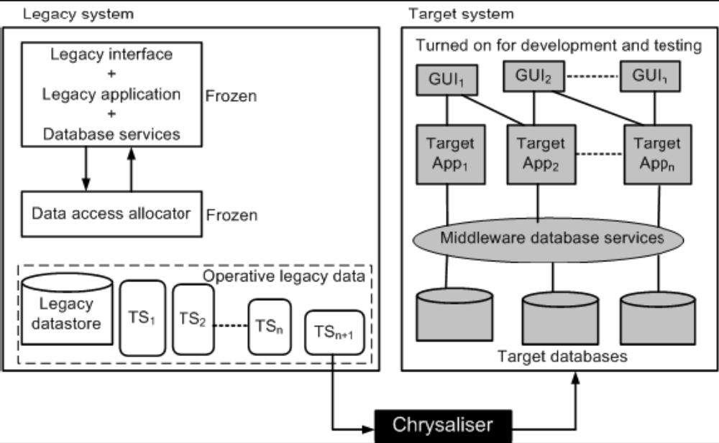
5.5.6 Butterfly
Phase 5: Gradually migrate the legacy data (Cont’d…)
Figure 5.11 and DAA working together serve as a data migration engine.
Figure 5.11 Migrating TempStore in Butterfly methodology ©IEEE, 1999
Notes:
Handouts

Slide 61
5.5.6 Butterfly
Phase 6: Roll over to the new system
Roll over to the new system is the final phase of the Butterfly methodology.
After the new system is built and the legacy data are migrated, the new system is ready for operation.
Drawback of Butterfly Methodology
The main drawback of the Butterfly methodology is that the legacy database is used for reading only, whereas modifications are placed in a separate, temporary database.
Consequently, when there is a need to access some data, the system reads both the databases – the old database nd the target database – plus the temporary database.
As a result, there is an increase in the time to access the required data.
Notes:
Handouts

Slide 62
5.5.7 Iterative
The iterative method implies that one component at a time is reengineered.
Thus, the legacy system gradually evolves over a period of time.
The methodology enables simultaneous operations of the reengineered system and the components of the legacy system.
The components of the reengineered system access either the legacy database or the new database, based upon the location of the actual data to be accessed.
Notes:
Handouts

Slide 63
5.5.7 Iterative
An iterative methodology partitions legacy data into two categories:
  Primary data: Primary data are those data that are essential to an application’s business functions.
  Residual data: These data are not required to carry out the application’s business functions, but are used by the legacy system.
Primary data comprise two kinds of data:
  Conceptual data: These data describe concepts specific to the application’s domain.
  Structural data: These data are needed to organize and support data structures that are used to correctly access the conceptual data.
Notes:
Handouts

Slide 64
5.5.7 Iterative
Data in the residual category comprise those data in the legacy store which will eventually be discarded.
The residual data are grouped into four categories:
  control data.
  redundant structural data.
  semantically redundant data.
  computationally redundant data.
Notes:
Handouts

Slide 65
5.5.7 Iterative
Each Component may be in one of the following states during the reengineering process:
  Legacy: This state means that the component has not been reengineered, which implies that it continues to be a legacy component.
  Restored: The structure of the component remains the same and it performs the same functions, but the component accesses data through the new Data Banker.
  Reengineered: The component has already been modified, and a desired level of quality has been achieved.
  New: The component was not part of the legacy system and has been newly added in order to introduce new functions.
Notes:
Handouts

Slide 66
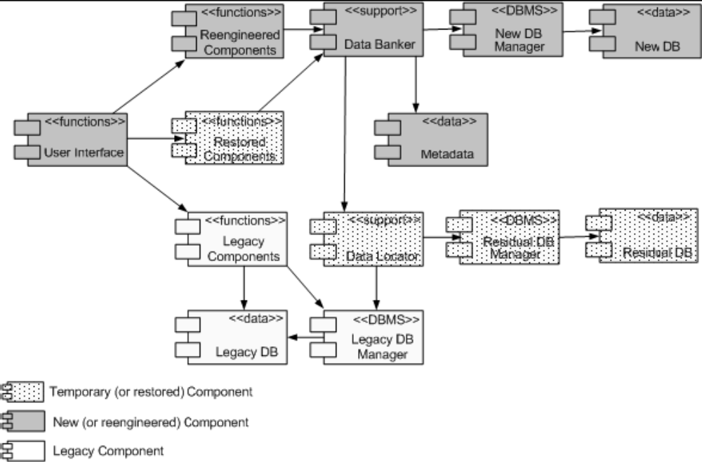
5.5.7 Iterative
System Architecture
While reengineering is in progress, Figure 5.12 shows the system architecture of gradual evolution of a legacy system.
Figure 5.12 The system architecture methodology during reemgineering ©IEEE, 2003
Notes:
Handouts

Slide 67
5.5.7 Iterative
System Architecture (Cont’d…)
The “Legacy DB manager” manages all accesses of the “Legacy DB” by the legacy components.
The database with the new structure is represented by “New DB.”
NewDB includes:
  (i) all primary data for those functions which have been added to the new system in the process of reengineering;
  (ii) all primary data which have been migrated from the legacy DB.
“Residual DB” stores the residual data from the legacy database, and “Residual DB Manager” is the corresponding data manager.
The “Residual DB Manager” may be the DBMS of the legacy software system or the new database.
The “Reengineered Components” and the “Restored Components” get data from “Data Banker.”
By means of “Meta Data,” “Data Banker” knows whether or not the required data is available in “New DB,” “Residual DB,” or “Legacy DB.”
Notes:
Handouts

Slide 68
5.5.7 Iterative
System Architecture (Cont’d…)
If the “Data Banker” needs to access the “New DB,” metadata are used to retrieve their physical locations.
Next, “Data Banker” uses the knowledge of the physical data locations to obtain data from the “New DB Manager.”
In the aforementioned two cases, “Data Banker” routes the requests for data to the “Data Locator.”
The “Data Locator” interprets the information that the “Data Banker” has extracted from metadata and gets the required data from the “Residual DB Manager” or the “Legacy DB Manager.”
Both the “Data Banker” and “Metadata” will continue to exist beyond the reengineering effort.
The structure of “New DB” is known to “Metadata” and the services of the “New DB Manager” are known to “Data Banker.”
Therefore, if there are changes to the physical structure of the “New DB”, only the contents of “Metadata” need to be modified.
On the other hand, changes to the “New DB Manager” requires changes to the “Data Banker” alone.
Notes:
Handouts

Slide 69
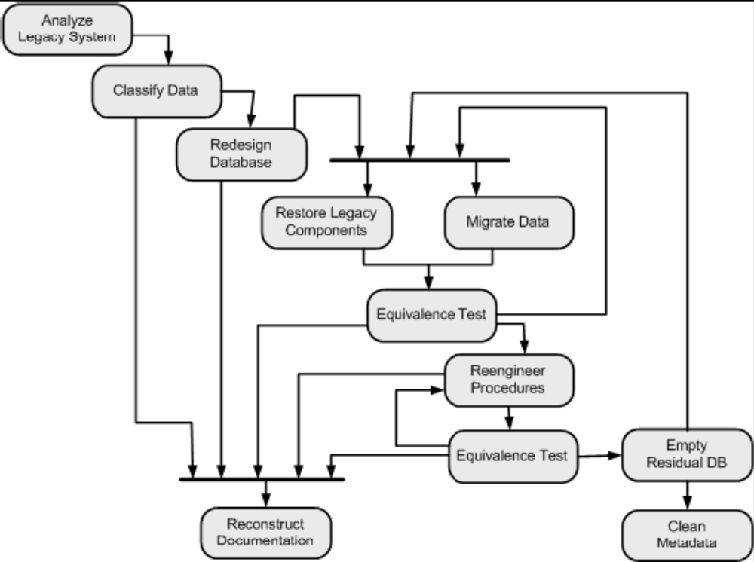
5.5.7 Iterative
Migration Process
Figure 5.13 The iterative migration process ©IEEE, 2003
Notes:
Handouts

Slide 70
5.5.7 Iterative
Migration Process
Analyze Legacy System:
All the change requests having an influence on a component to be reengineered are put aside until the component is reengineered.
Therefore, the system is partitioned into components so as to minimize their client-supplier relationships for two reasons:
  (i) to minimize the number of change requests (CRs) to be frozen.
  (ii) to minimize the time durations for which CRs are frozen.
Hence, in the partitioning process, identify the legacy system’s components which minimize the impact of reengineering the system.
Classify Data:
Legacy data are classified as primary or residual data.
All the data in the Legacy DB, which are non-duplicated, are recorded in a table produced by means of data classification.
Notes:
Handouts

Slide 71
5.5.7 Iterative
Migration Process
Redesign Database:
The data classified before are restructured in this phase:
  (i) to reorganize them in the new database for more effective and efficient access.
  (ii) to eliminate all the defects in the legacy database.
  (iii) to eliminate redundant data.
While describing the mode of access for the new database, define the characteristics of the data to be stored in the database for Metadata.
Restore Legacy Components:
The legacy system program is made compatible with the new database.
To make the program compatible, the codes involved in accessing the data are identified.
The identified code are replaced with new ones that call the Data Banker, rather than access data directly.
Notes:
Handouts

Slide 72
5.5.7 Iterative
Migration Process
Migrate Data:
The legacy database is incrementally migrated to the new database, and non-essential data are put in the residual database.
A data migration tool can be developed for this purpose.
For each data file to be reengineered, the tool must read all the data it contains, copies them into the Residual DB or New DB based on the information contained in the Metadata.
Reengineer Procedures:
Functions are reengineered in this phase, thereby evolving them from the restored state to the reengineered state.
Quality deficiencies of the procedures are analyzed and suitable remedies are introduced.
While reengineering, original components of the legacy system are reused as much as possible for two reasons:
  (i) reduce the cost of reengineering.
  (ii) preserve the skills that the maintainers have developed.
Notes:
Handouts

Slide 73
5.5.7 Iterative
Migration Process
Equivalence Tests:
Equivalence testing ensures that, after migration, the system continues to execute the same way as it did before.
Tests are conducted after procedure restoration and data migration.
In addition, this phase allows the test plan documentation to be updated.
Empty Residual DB:
In iterative reengineering, some parts of the legacy database are migrated into the New DB, whereas the remaining parts move into the Residual DB.
While performing reengineering in an iterative manner, data to be no longer used are removed from the Residual DB.
Therefore, by the end of the reengineering process, the Residual DB will be completely empty.
Consequently, the Residual Data Manager and the Data Locator components can be withdrawn from the system.
Notes:
Handouts

Slide 74
5.5.7 Iterative
Migration Process
Iteration:
The components of the legacy system are reengineered one at a time.
After reengineering a selected component, the process is repeated for another component and so on, until the entire system has been reengineered.
Clean Metadata:
Upon completion of reengineering, Metadata only reflects the contents of the New DB.
Therefore, metadata concerning Residual DB are no more needed; hence, those are eliminated from Metadata.
In addition, all procedures in the Data Banker, which communicate with the Data Locator are removed.
Reconstruct Documentation:
Documentation reengineering proceeds concurrently with the actual migration.
Up-to-date documentation can be performed throughout the reengineering process.
Notes:
Handouts

Slide 75
Summary
  General Idea
  Wrapping
  Migration
  Migration Planning
  Migration Methods
Notes:
Handouts

